Slide 1
SocialQ’s – Intro Storyline
V1.0.0 – SocialQ’s Story Line MVP

Slide 2
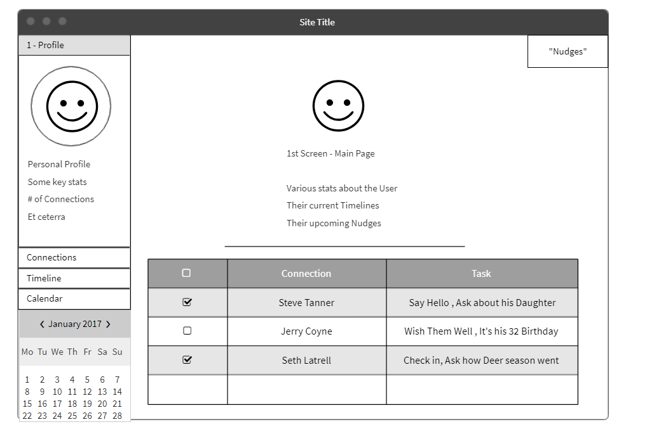
HomePage

Slide 3
Home Page Notes
Home page – default to Profile (User)
Connections
Timeline
Calendar (unlikely in MVP)

Slide 4
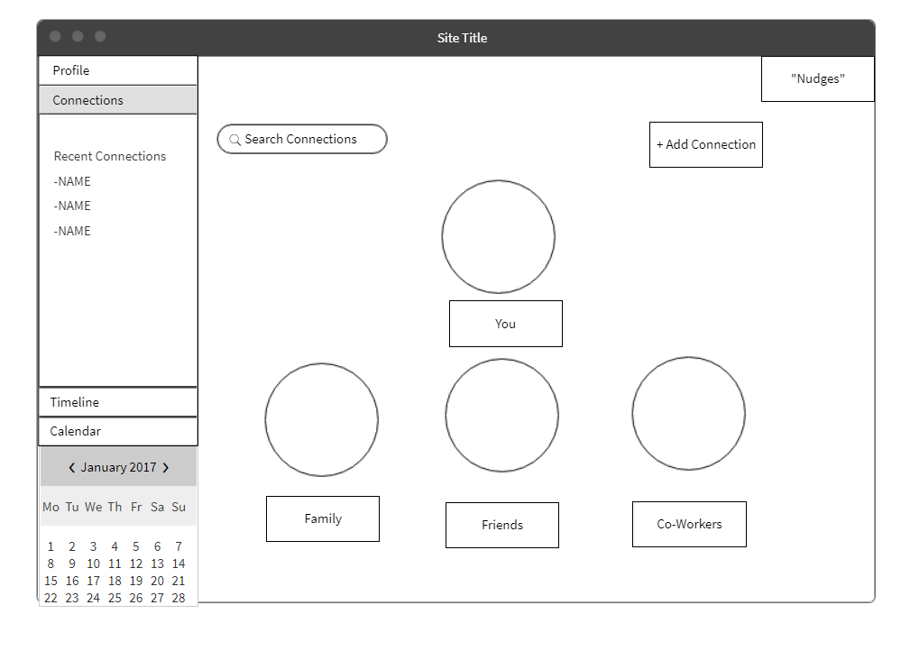
Connections

Slide 5
Connections
Grouped by Relationship Type
Family / Friends / CoWorkers
We can probably create other catagories
  College Friends / UNH programmers

Slide 6
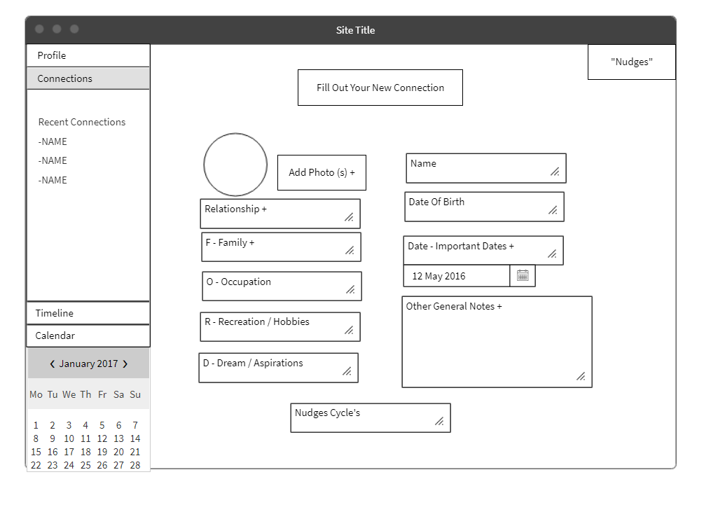
New Connection

Slide 7
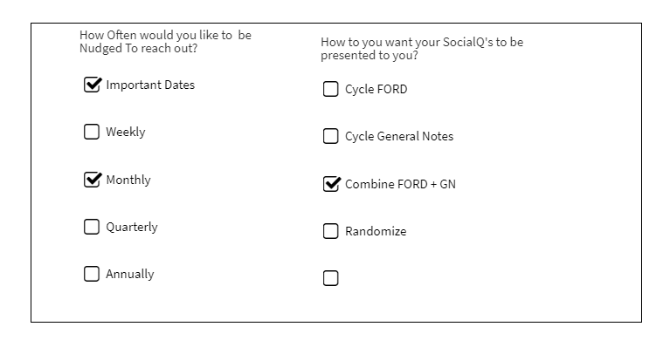
Nudging Cycle - Modal

Slide 8
New Connection
Basic input from Laurie’s Outline
Completed Connection page has same info
  In addition to List of past and upcoming “nudges”
Recurrence Cycle is 2 part based
  The frequency of nudges
  The Promps cycle

Slide 9
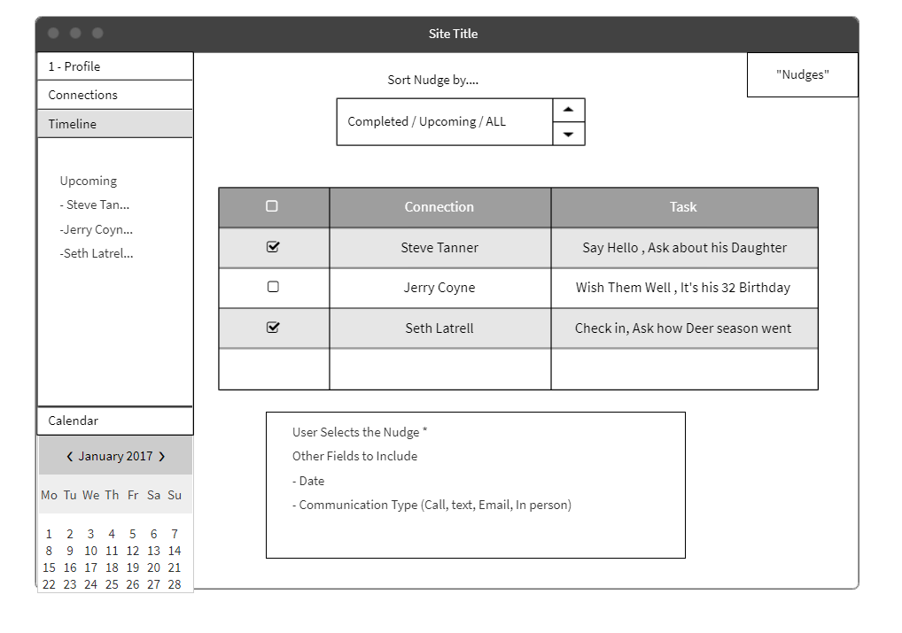
Timeline

Slide 10
Timeline
Time line is “Nudge” focused
Lining up “nudges” based on selected criteria
  Sort by Upcomming
    Completed

Slide 11
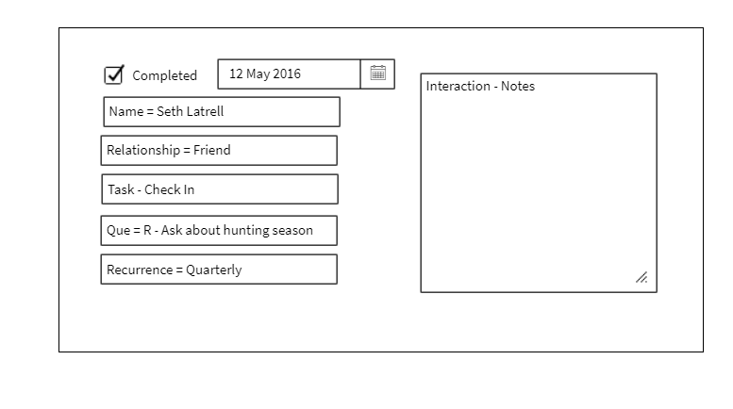
Nudge Complete – Modal

Slide 12
The Completed Nudge
Similar to how Mike described Cigna example
User clicks line item
Form appears
  User fills out the boxes

